Slide 1
CyberShield Guardian
Team: Quantum Protectors | VibeAIthon 2025
Notes:
© Copyright PresentationGO.com – Free Templates & Infographics for PowerPoint and Google Slides

Slide 2
Problem Statement
.Women face rising threats in public spaces.
- Current safety apps can be faked, delayed, or deleted.
- A real-time, trusted, and secure solution is needed
Notes:
© Copyright PresentationGO.com – Free Templates & Infographics for PowerPoint and Google Slides

Slide 3
Solution Overview
- CyberShield Guardian detects danger, secures data, and sends instant SOS alerts.
- Combines AI, wearables, and blockchain for trust and protection.
- Tamper-proof and encrypted alerts ensure reliability.

Slide 4
Desirability
- Users: Students & working women traveling alone.
- Need: Reliable, auto-detecting safety system.
- Impact: 90% of surveyed women prefer cyber-secured safety apps.

Slide 5
Feasibility
- Uses AI/ML algorithms for motion and voice stress analysis.
- IoT smart bands track heart rate and movement.
- Phases:
1. Design & Planning
2. Prototype & Development
3. Testing & Feedback.
Notes:
© Copyright PresentationGO.com – Free Templates & Infographics for PowerPoint and Google Slides

Slide 6
Viability
- Low-cost, scalable, and energy-efficient model.
- Revenue: Freemium app + partnerships (colleges, NGOs).
- Market: 500M+ women in India could benefit.

Slide 7
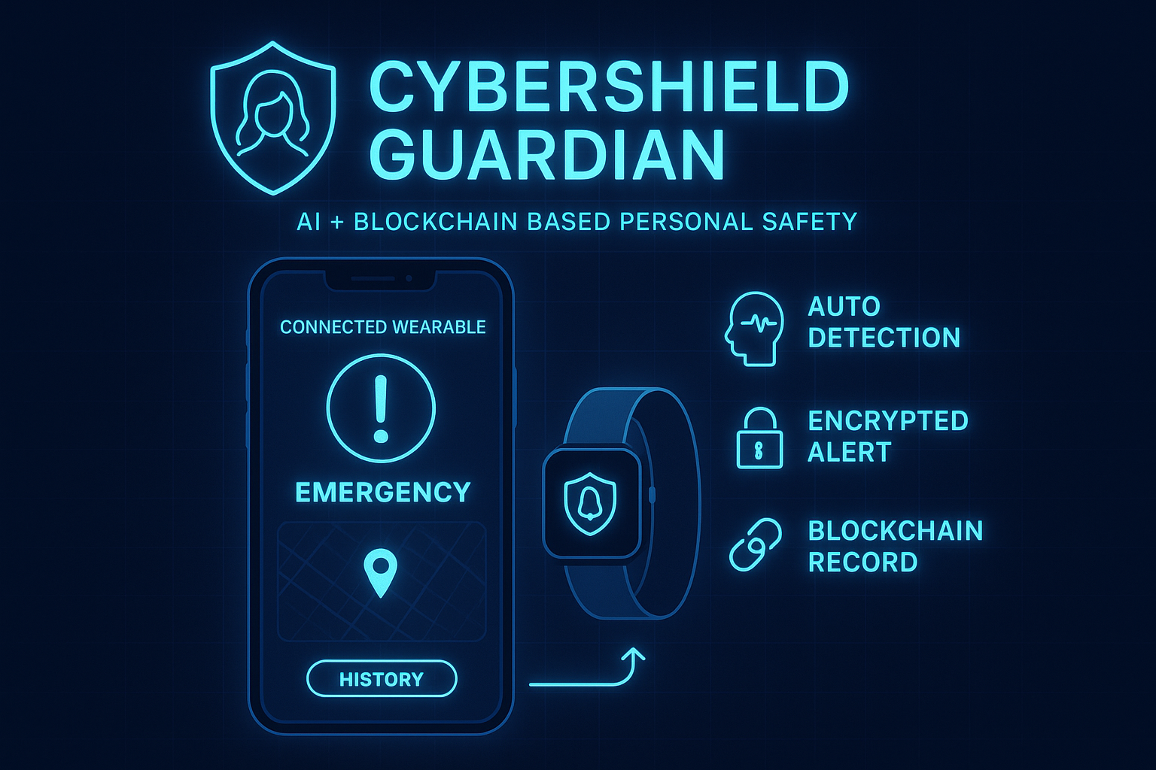
Prototype / Demo
- App UI: Live heart rate, motion, and SOS button.
- Workflow:
Wearable detects → AI verifies → Blockchain alert → Responders notified → Safety confirmed.

Slide 8
Roadmap
- 0–30 Days: Design & structure.
- 31–60 Days: Development & integration.
- 61–90 Days: Testing & refinement.
- Future: Expand citywide → Nationwide → Global partnerships.

Slide 9
Team & Roles
Thoyeshwar | Project Lead | AI Integration, Concept Design
Sivanesan | Data Analyst | Blockchain & Encryption
Tharun | Hardware Specialist | IoT & Wearable Systems
Shanjay | Designer | UI/UX & Visual Design
Syed Rameez | Tester | App Testing & User Feedback

Slide 10
Ask
- Feedback: Improve tech & design.
- Support: Mentorship for AI, Blockchain, Wearable integration.
- Opportunities: Pilot testing & collaborations.
Notes:
© Copyright PresentationGO.com – Free Templates & Infographics for PowerPoint and Google Slides

Slide 11
Thank You!
Contact Details (Draft):
- Email: [thoyesh08@gmail.com]
- LinkedIn: [Thoyeshwar-https://www.linkedin.com/in/thoyeshwar-l-a77946325/
Shanjay-https://www.linkedin.com/in/shanjay-u-19365735b
Sivanesan-https://www.linkedin.com/in/sivanesan-shiva-07268b264/
Tharun-https://www.linkedin.com/in/tharun-k-s-176a24389/
Syed Rameez-https://www.linkedin.com/in/ameer-jan-58ba4a389/]
- GitHub: [https://github.com/Rex-Legend]

Slide 12
FINAL OATH
"From Code to Courage — Protecting Women Everywhere."
Notes:
© Copyright PresentationGO.com – Free Templates & Infographics for PowerPoint and Google Slides

